Slide 1
Vert.x
Asynchronous and Reactive Programming

Slide 2
Main points
What is Eclipse Vert.x?
A Fast Prototype for a starter
Improving the design by refactorings
Separation of concerns at Vertices level
Extracting Vert.x services
Junit tests for testing asynchronus code.
Consumming && Exposing third party HTTP/Json services
Going further

Slide 3
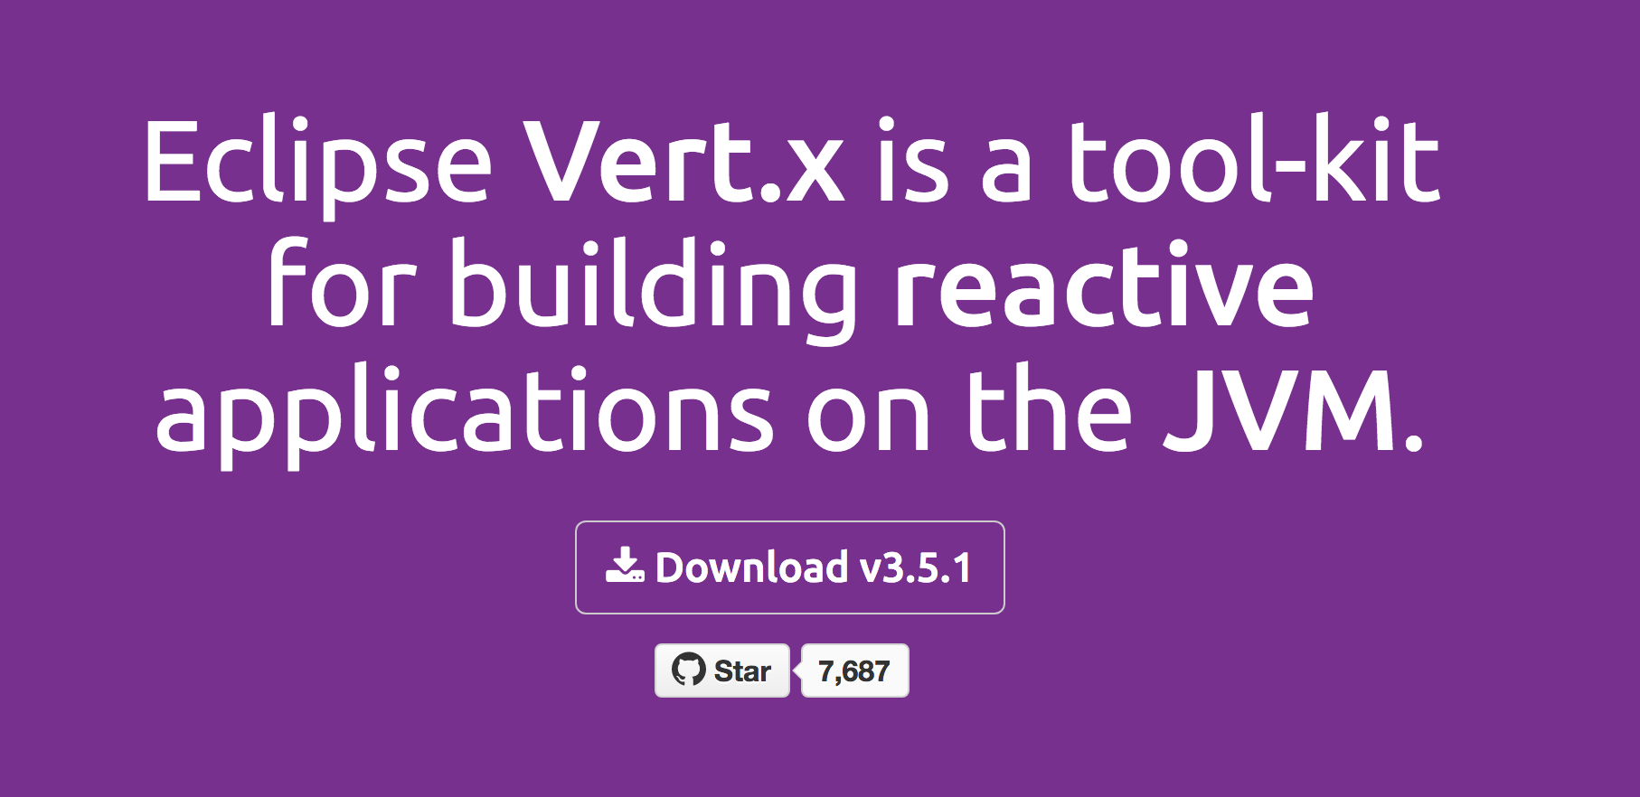
What is eclipse vert.x?

Slide 4
Section – I:
Basics of Vert.x
Vert.x is not a Framework, but a toolkit. The core libraries define the fundamental APIS for writing asynchronous networked applications
Then you pick the other useful modules for your application
DB Connection
Monitoring
Authentication
Logging
Service Discovery
Clustering support
Vert.x is based on the Netty Project

Slide 5
Which build env?
No one in particular
Or…The one you prefer
Vert.x Core is a simple jar
It can be embedded inside apps packaged as a Set of jars
Or it can be deployed inside popular components and application containers

Slide 6
Why use vert.x?
Vert.x is designed for aynchronous communications
It can deal with more concurrent network communications with less threads than synchronous APIs such as java servlet or java.net socket classes
It is usefull for a a wide range of applications
➔ High volume message /event processing
➔ Micro services
➔ API Gateways
➔ http Apis for mobile applications
➔ But also, … more traditional web apps (not limited to the heavy/complex or high demanding type of apps)

Slide 7
Building with asynchronicity in mind
The Vert.x code does not look as complex as it sounds
But if there is a sudden peak in traffic, then the code is already written with the essential ingredient for scaling up:
Asynchronous Processing of Events

Slide 8
What language does it speak?
It‘s polyglot
Java
Groovy
Scala
Kotlin
Javascript
Ruby
Celon
Also the language specific API are idiomatic in each target language (example. Using Scala futures in place of Vert.x futures)

Slide 9
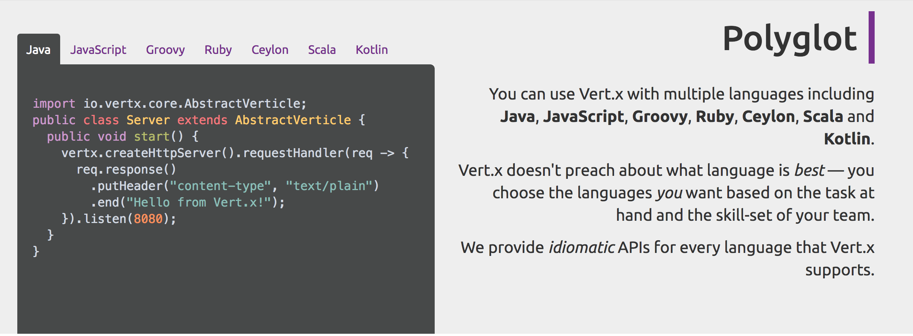

Slide 10
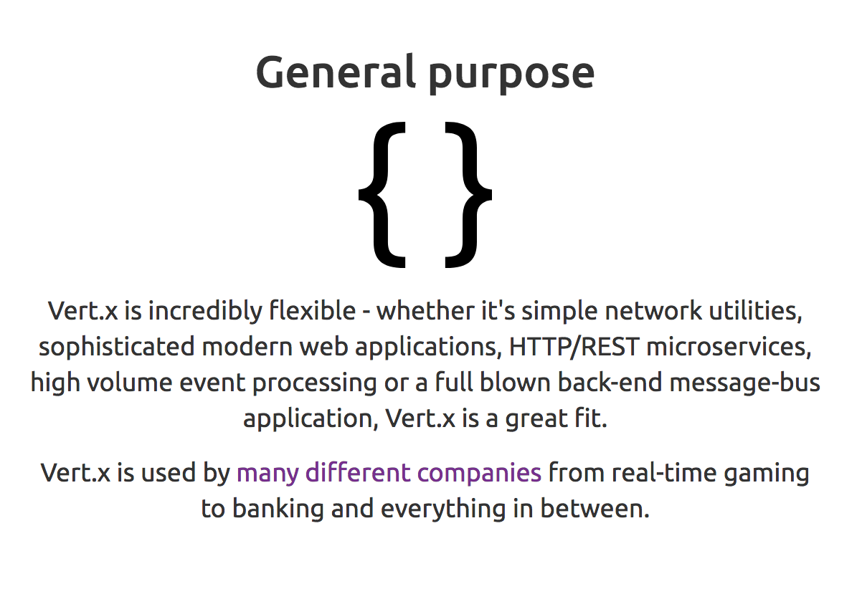

Slide 11
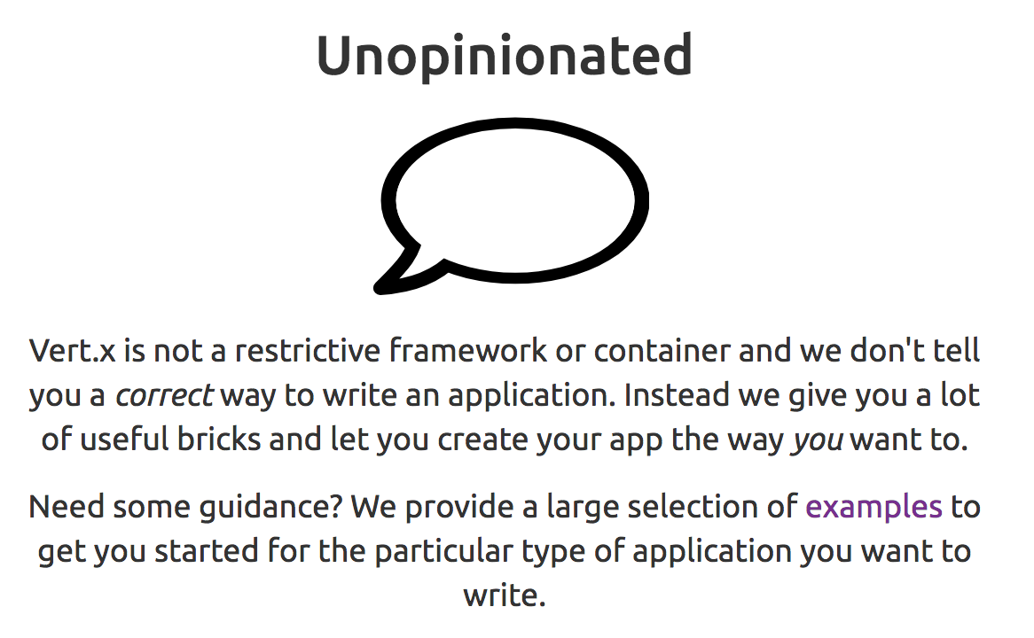

Slide 12
Core concepts
Verticles and event Bus communication

Slide 13
Verticles and the bus communication

Slide 14
Threading and programming models
The traditional approach sucks by scalability !
One thread per network client
Assigned generaly at the establishment of the connection
Used for example with Servlets
Or network coding written with java.io and java.net
It‘s a „synchronous IO Threading model“
It looks simple as programming model
It sucks by scalability
Too many concurrent connection as threads are not cheap
Under heavy load, thread management and scheduling becomes itself heavy by the Operating System
Thus we need „asynchronous IO“ and Vert.x is here to help

Slide 15
Verticles
Transitioning to a better world!!!

Slide 16
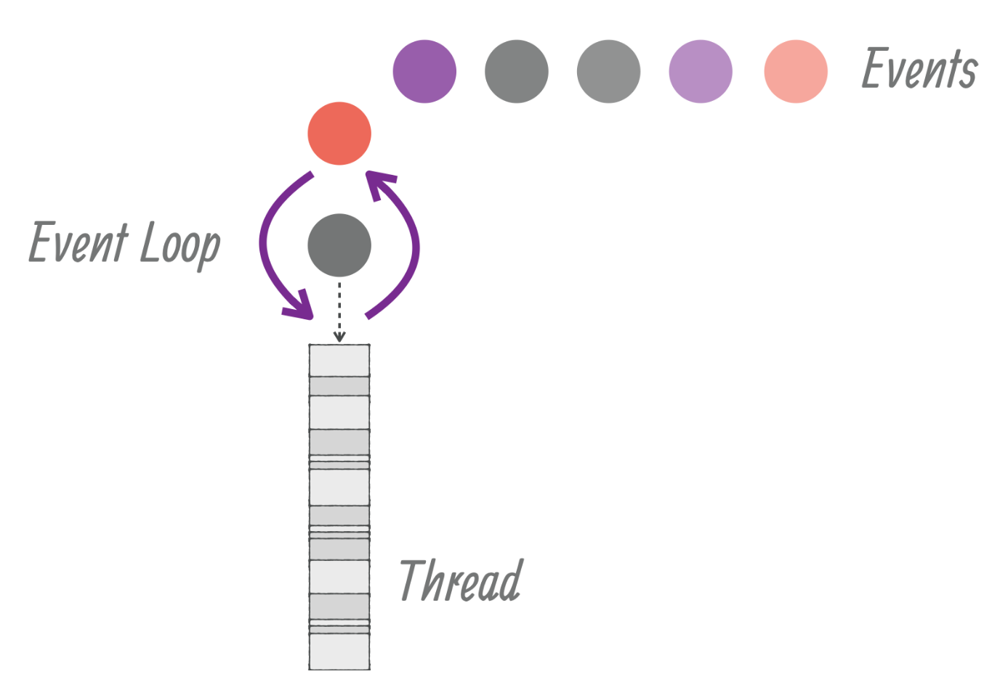
verticle: the unit of deployment
The unit of deployment is called a verticle.
A verticle processes incoming event over an event loop
Events can be anything
→ receiving network buffers
→ timing events
→ messages sent by other verticles

Slide 17
The politicaly correct event handling by a verticle
Each event shall be processed in a reasonable amount of time to not block the event loop
Therefore no thread blocking operation shall be performed while executed on the event loop
Exactly like processing event in a graphical user interface (for example freezing a swing interface by executing a slow network operation)
Vert.x offer mechanisms to deal with blocking operations outside the event loop

Slide 18
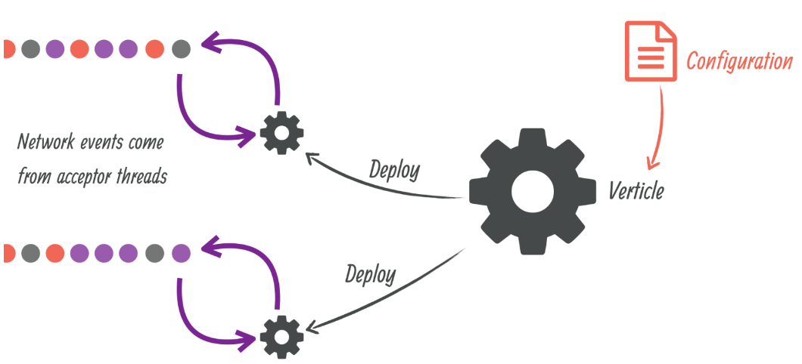
characteristics
Every event loop is attached to a thread
By default Vert.x attaches two event loop per Core cpu thread
As a consequence a regular verticle always process events on the same thread
So there is no need for a thread cop
A verticle can be passed some configurations: credentials, network adresse, etc
A verticle can be deployed several times

Slide 19
characteristics
Incoming network datas are being received from accepting threads and then passed as events to the corresponding verticles
When a verticle opens a network server and is deployed more than once, then the events are being distributed to the verticle instances in a round-robin fashion which is very useful for maximizing CPU usage with lots of concurrent networked requests
Verticles have a simple start/stop lifecycle
Verticles can deploy other verticles

Slide 20
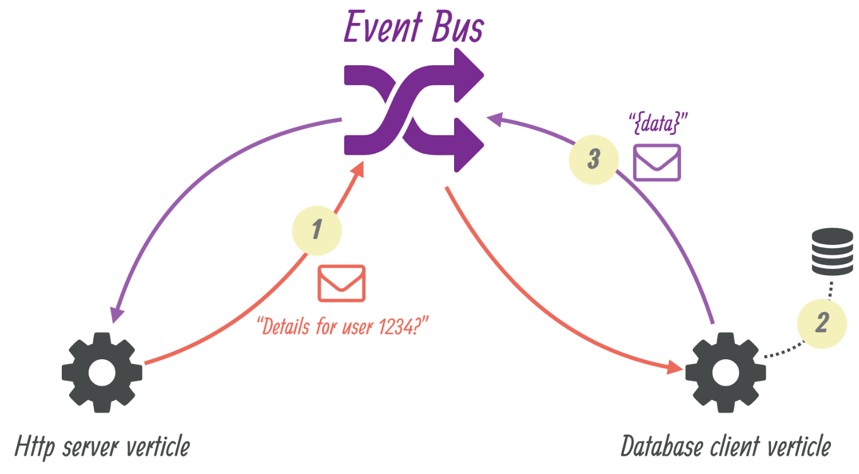
Message exchange through the event bus

Slide 21
Characteristics of the event bus
All kinds of datas can transition between verticles through the event Bus
Json is the preferred format because it is cross language.
Messages can be sent to destinations which are free form strings
The event bus supports the following communication patterns
Point to point messaging
Request-response messaging
Publish/Subscribe for broadcasting messages

Slide 22
…
Via the Event Bus, verticles can transparently communicate accros the same JVM or accross different JVMs
when network clustering is activated, the event bus is distributed so that messages can be sent to verticles running on other application nodes,
Third party apps can communicate with each others via the Event Bus using a simple TPC protocol
The event bus can also be exposed over general purposes message bridge (example: AMQP, Stomp…)
a SockJS bridge allows web applications to seamlessly communicate over the event bus from JavaScript running in the browser by receiving and publishing messages just like any verticle would do.

Slide 23
First demo
Wikipeaks

Slide 24
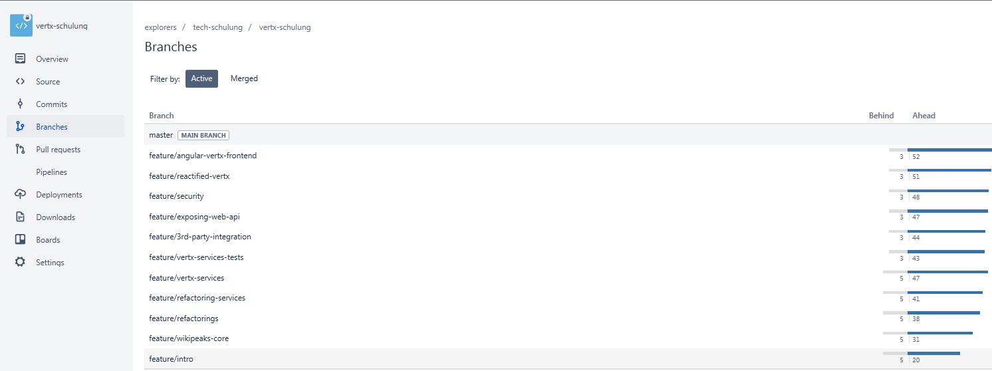
Wikipeaks branches

Slide 25
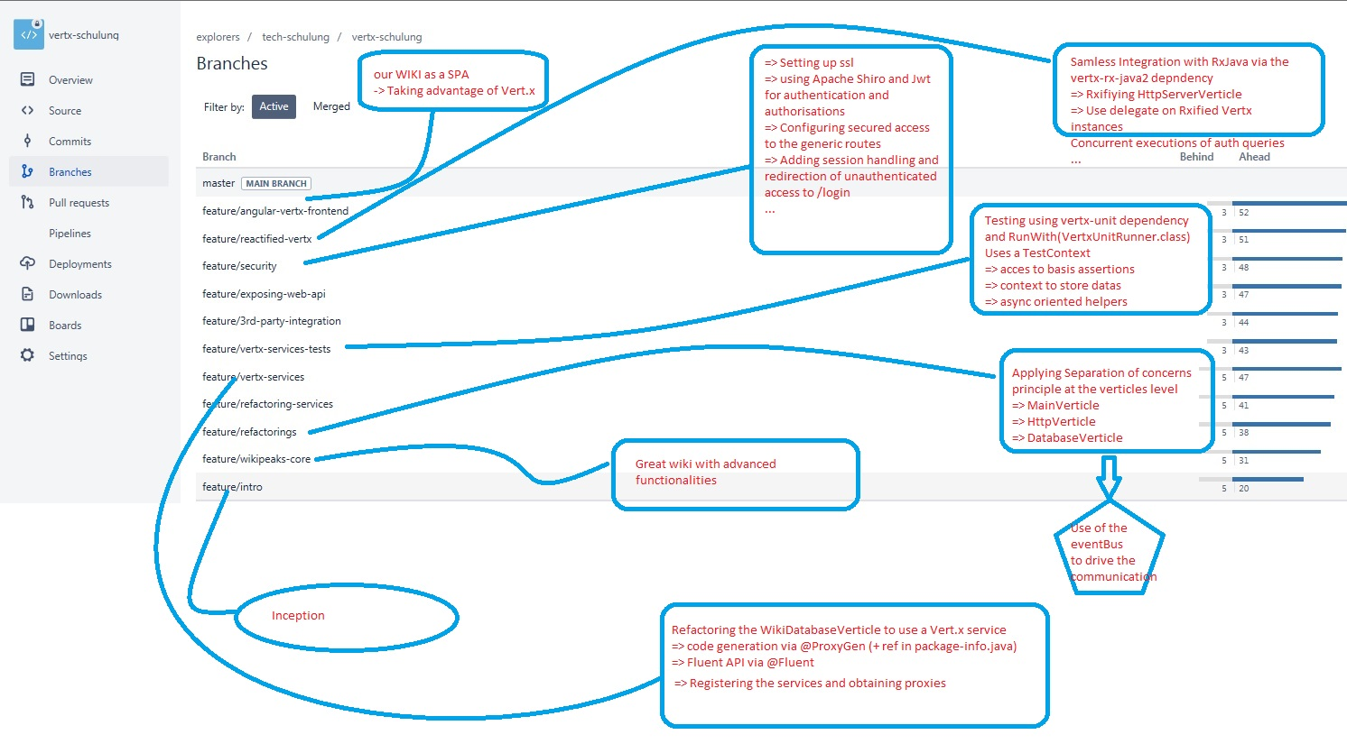

Slide 26
What is it?
A quick prototyping of a wiki app using Vert.x
Server-side rendering of Html pages
Data access through a JDBC connection
Using the following librairies
➔ Vert.x web : provides elegant API to deal with routing, handling of request payloads, etc….
➔ Vert.x JDBC Client: provides an asynchronous API over JDBC
➔ Apache Free Marker: templating engine
➔ TxtMark: render markdown text as html allowing edition of wiki pages with markdown
Bootstrapped maven project using: https://github.com/vert-x3/vertx-maven-starter
Creating a fat jar with the help of Maven Shade Plugin

Slide 27
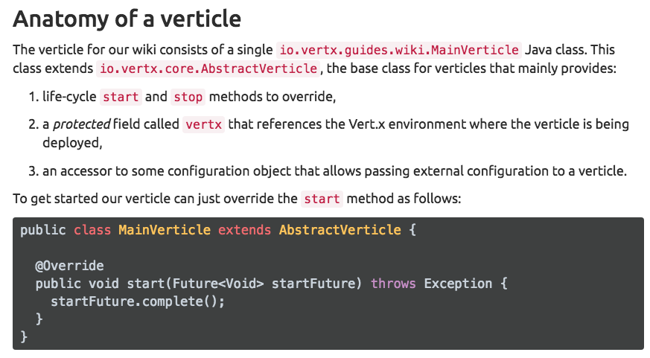

Slide 28
Composition of vert.x future
Vert.x futures are not JDK futures.
They can be composed and queried in a non-blocking fashion.
They shall be used for simple coordination of asynchronous tasks, particularly for:
Deploying verticles
Checking if they are successfully deployed or not
The Vert.x core APIs are based on callbacks to notify of asynchronous events

Slide 29
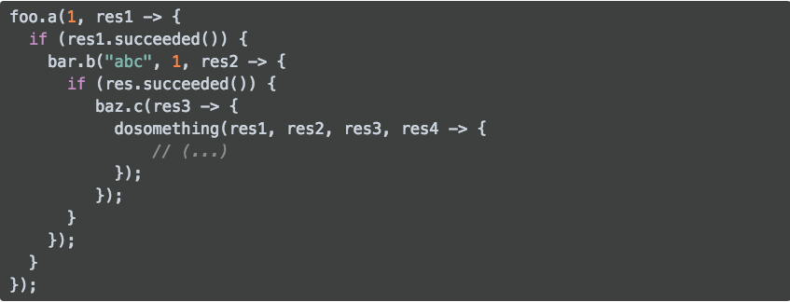
Avoid callback hell type of programming

Slide 30
Wikipeaks verticle initialisation phase
We need to establish a JDBC db connection and make sure the db schema is in place
And we need to start a http server for the web app
Each phase can fail (ex: http port is not available, …)
They should not run in parallel as the web app needs the db access to work first

Slide 31
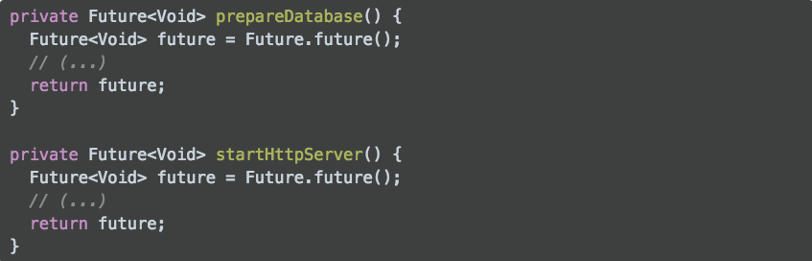
Code structure

Slide 32
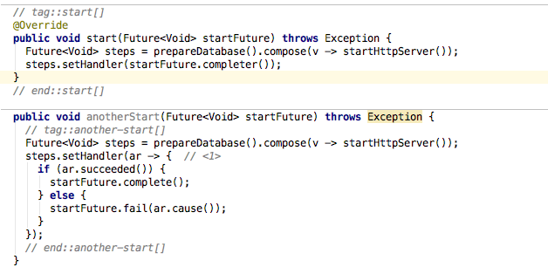
Composition in the start method
By having each of our main process returns a Future, the start method becomes a composition

Slide 33
What happens in start
When the future of prepareDatabase completes successfully, then startHttpServer is called and the steps future completes depending on the outcome of the future returned by startHttpServer
startHttpServer is never called if prepareDatabase encounters an error, in which case the steps future is in a failed state and becomes completed with the exceptions describing the error
Eventually steps completes: setHandler defines a handler to be called upon completion. In our case we simply want to complete startFuture with steps and use the completer method to obtain a handler: the two start methods shown above are equivalent

Slide 34
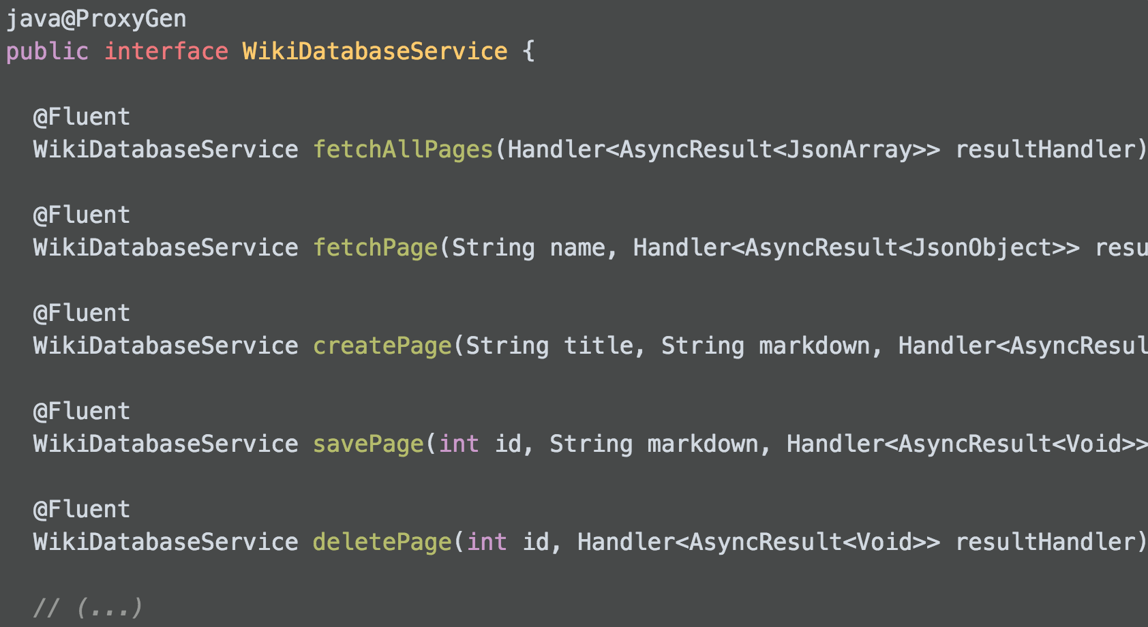
Using vert.x service

Slide 35
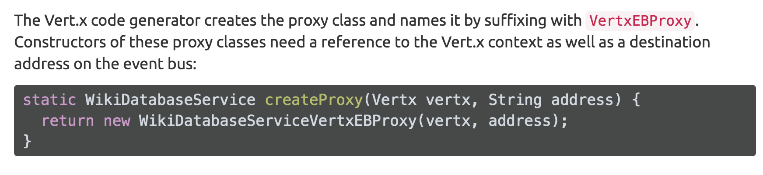
Obtaining a service proxy

Slide 36
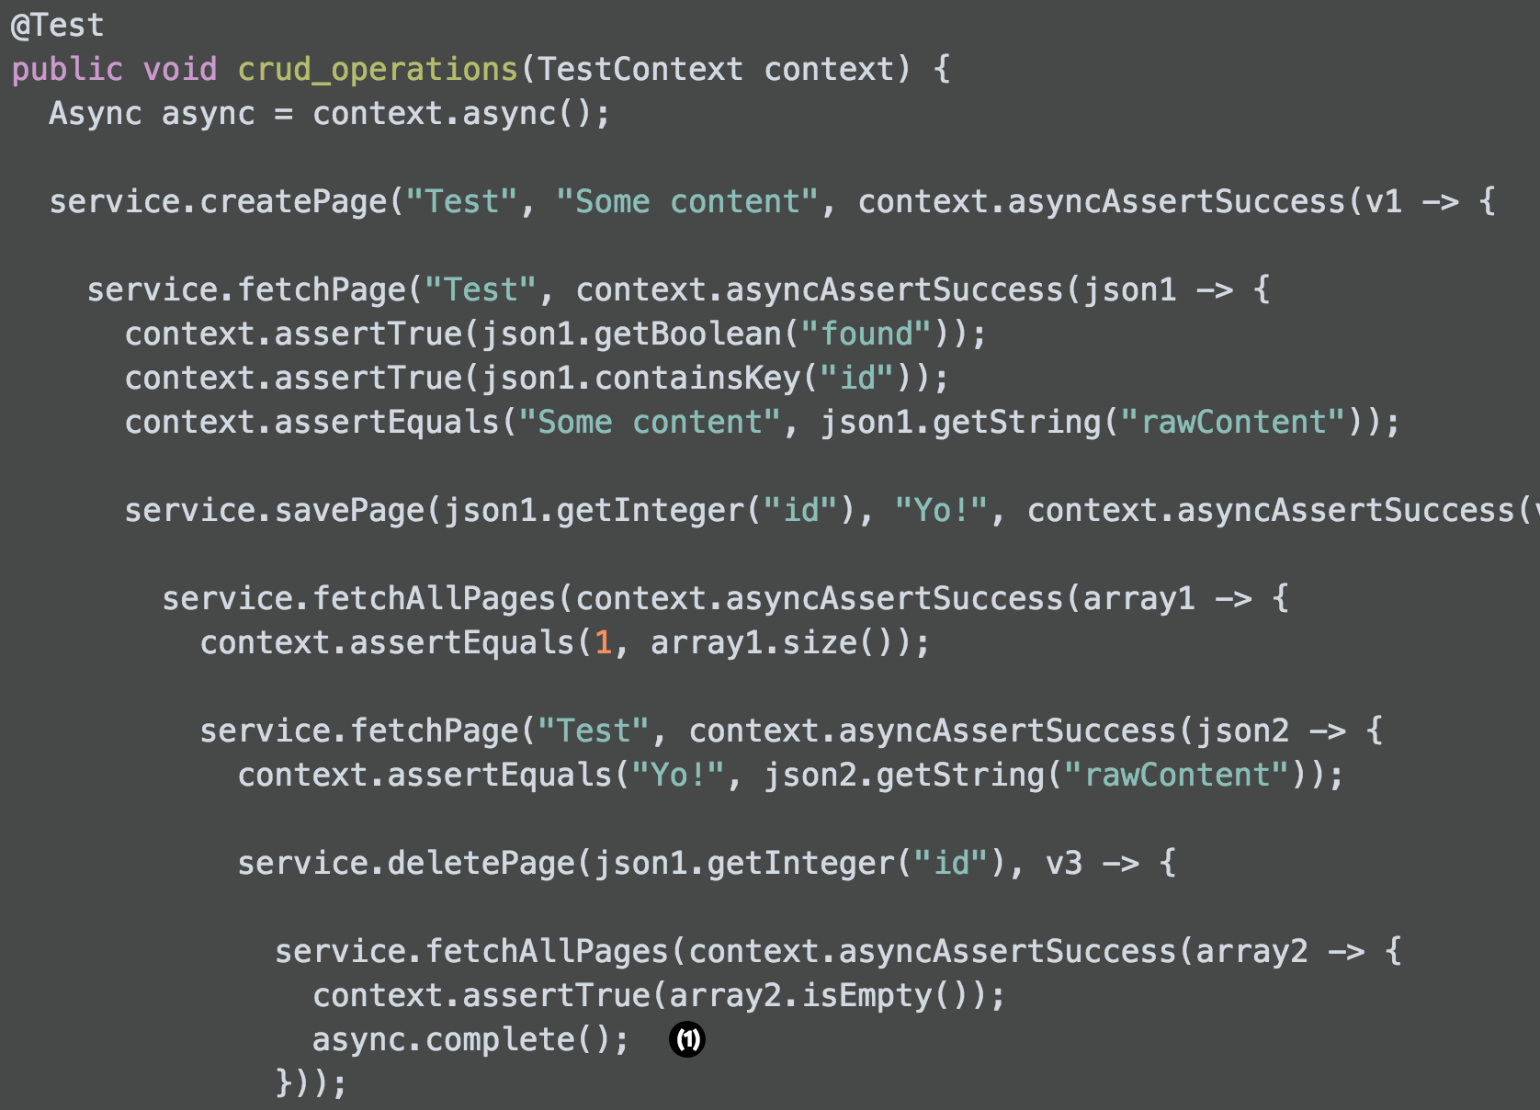
Testing with asynchronicity in mind

Slide 37
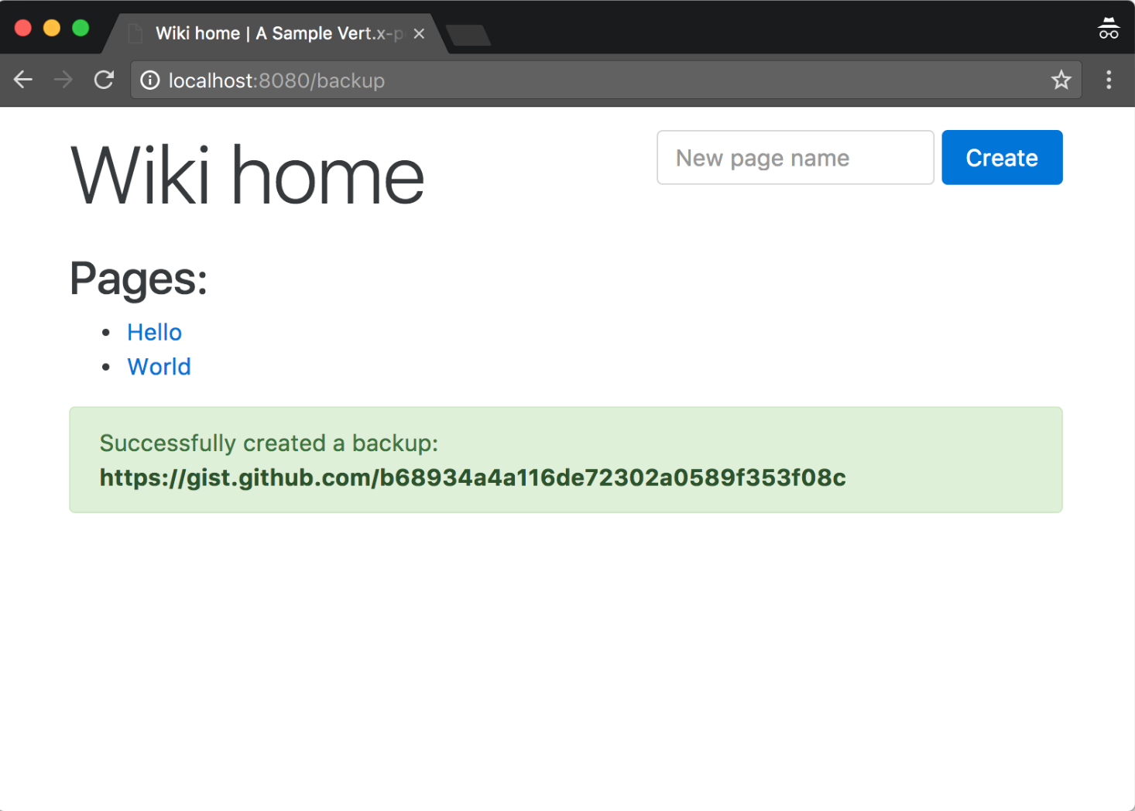
Integrating 3rd party-api

Slide 38
securing
Authentication and Access Control

Slide 39
Main points
Moving from http to https
Add user authentication with groups based priviledges
Control access to the web api using Json Web Tokens (JWT)

Slide 40
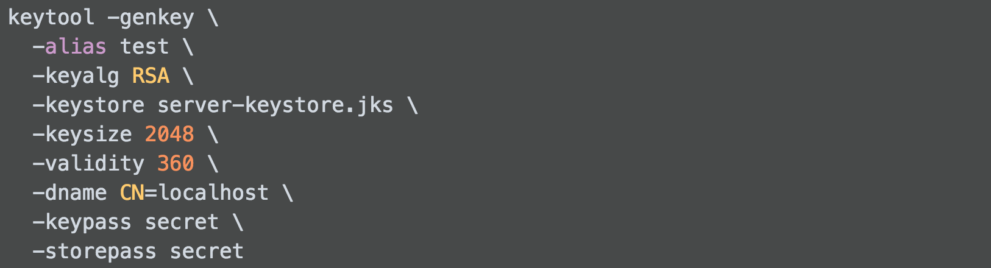
Generating a self – signed certificate

Slide 41
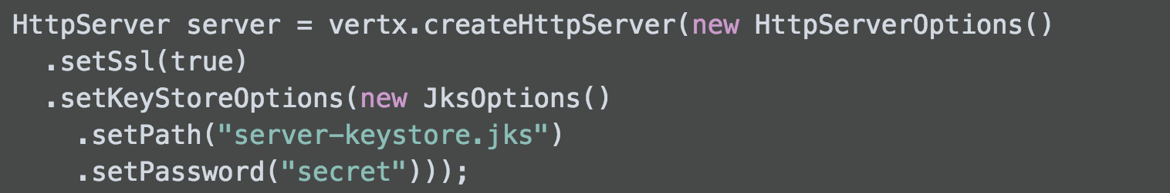
Activating ssl
At the HttpServer creation we pass a HttpServerOptions object to specify that we want SSL and to point to our KeyStore file:
By pointing to our sever (http://localhost:8080) we get the standard security exception common
To most browsers since our certificate is self - signed

Slide 42
Options for authentication and authorisations
There is a wide range of options for that with Vert.x
=> JDBC, MongoDB, Apache Shiro, OAuht2,
With well known providers
Or with Jwt

Slide 43
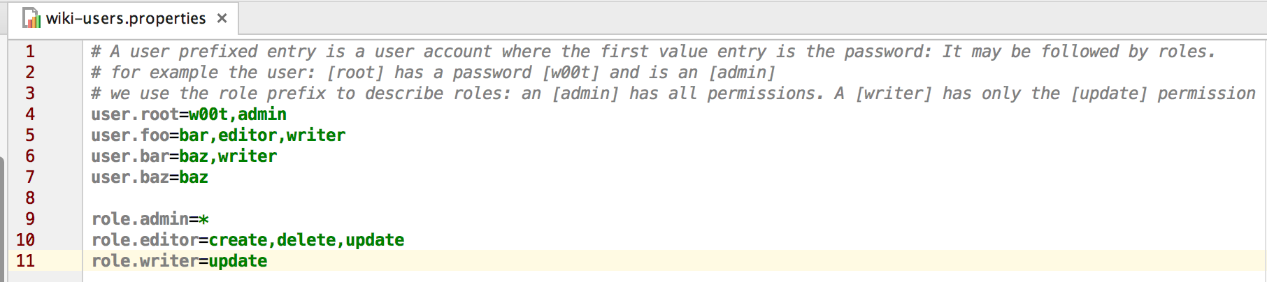
Basics users/Permissions/roles config

Slide 44
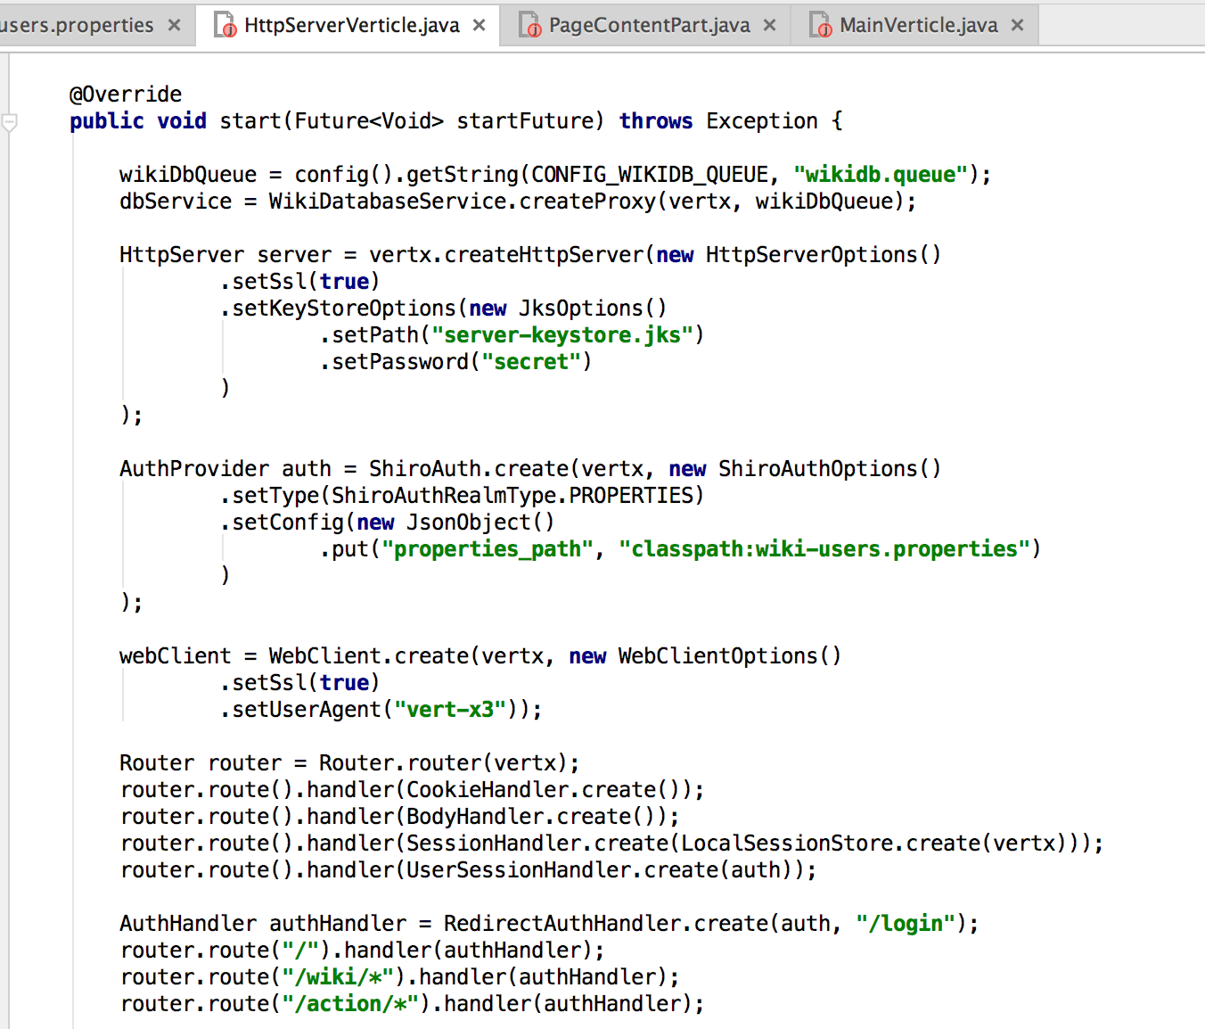
Adding security to the httpserververticle

Slide 45
Going reactive
With Vert.x integration with React

Slide 46
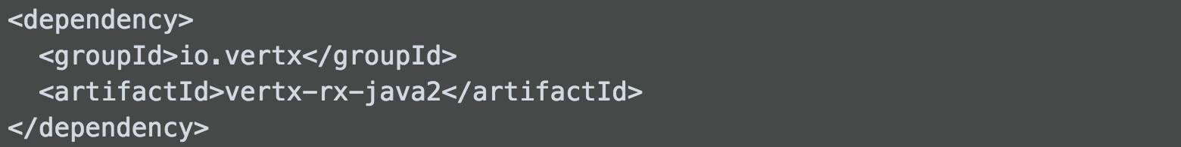
Integration with Rxjava
Done via the dependency: vertx-rx-java2
To create a Verticle we do not extend io.vertx.core.AbstractVerticle anymore, but:
io.vertx.reactivex.core.Vertx
Thus we have an idiomatic API extension

Slide 47
Why using rxJava?
The callback based API of Vert.x stack works well but it can become a bit tedious when we have to handle several source of events and deal with complex data flows.
That‘s where RxJava shines and Vert.x integrates well with it.

Slide 48
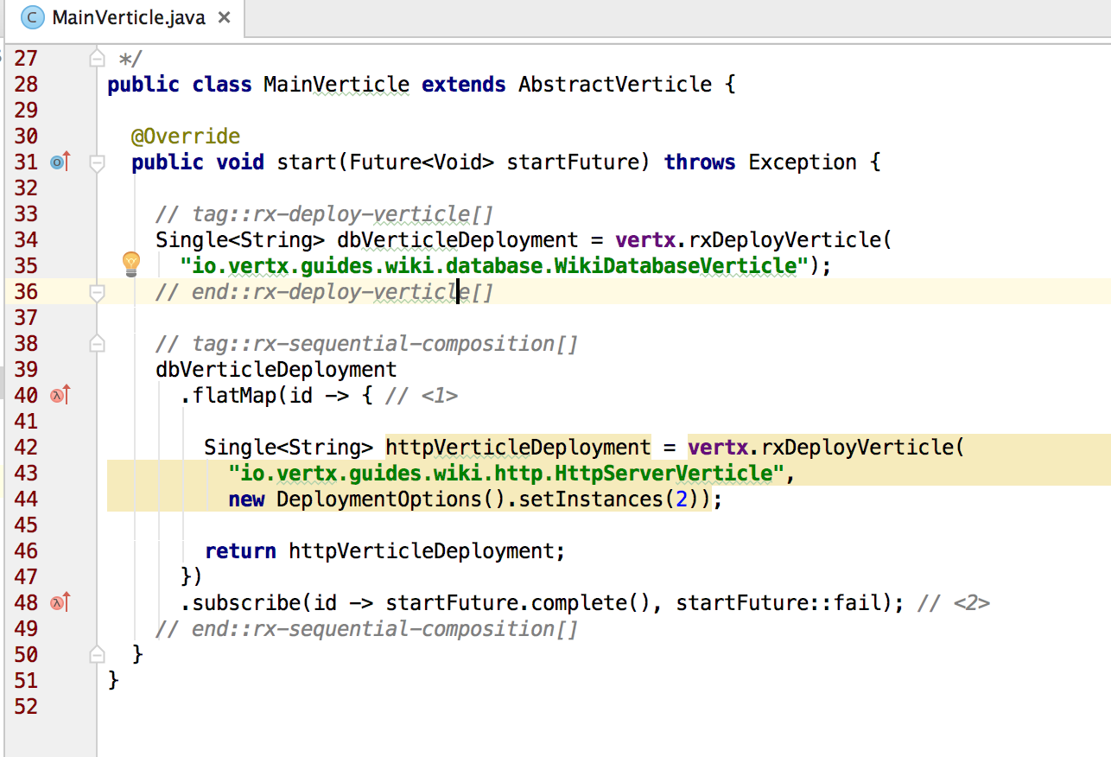
Example: the MainVerticle

Slide 49
Changes in deployment approach
The rxDeploy method does not take a Handler<AsyncResult<String>>
As a final Parameter, instead it returns a Single<String>
Besides, the operation does not start when the method is called.
It starts when you subscribe to the Single. When the operation completes,
it emits the deployment id or signals the cause of the problem with a Throwable.

Slide 50
Executing authorization queries concurrently
In the previous example, we saw how to use RxJava operators and the Rxified Vert.x API to execute asynchronous operations in order.
But sometimes this guarantee is not required, or you simply want them to run concurrently for performance reasons.
The JWT token generation process in the HttpServerVerticle is a good example of such a situation.
To create a token, we need all authorization queries to complete, but queries are independent from each other:

Slide 51
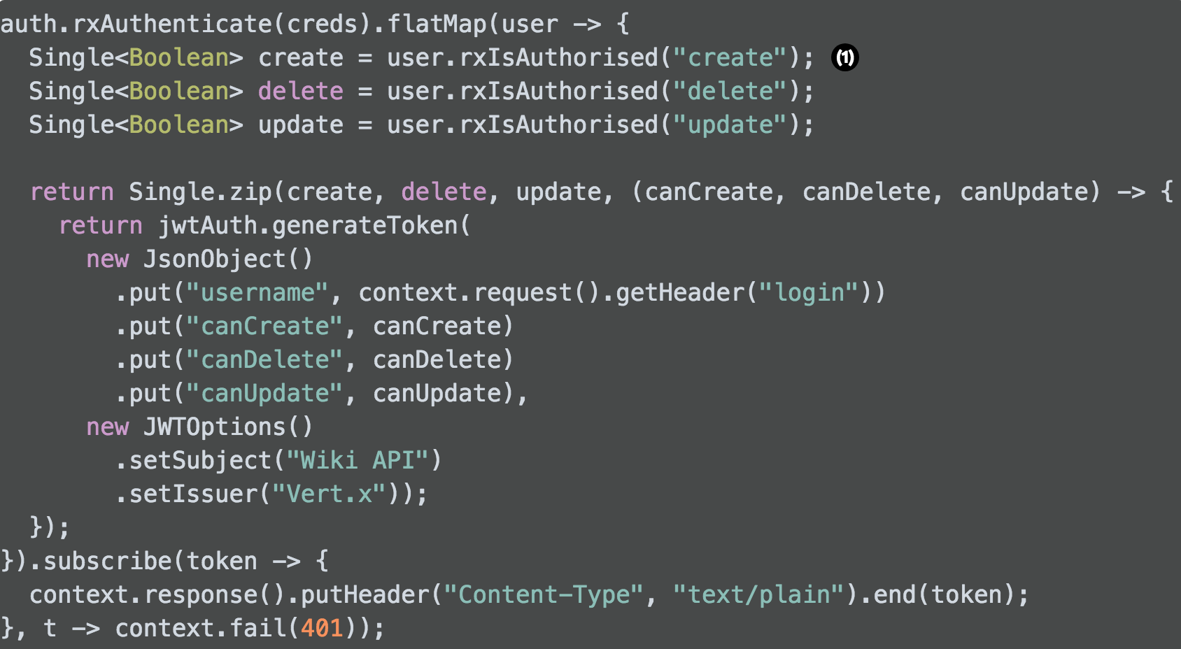

Slide 52
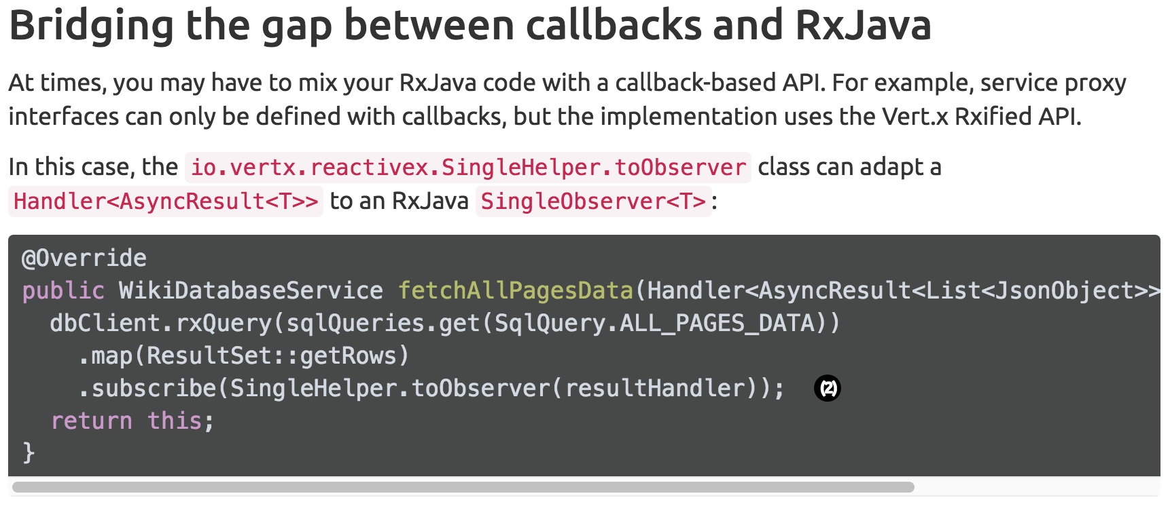

Slide 53
demo
WIKIPEAKS as a SPA

